Slide 1
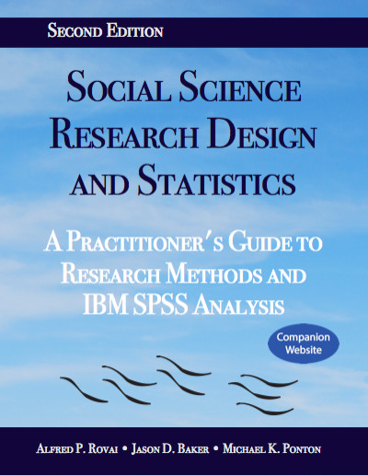
Social Science Research Design and Statistics, 2/e Alfred P. Rovai, Jason D. Baker, and Michael K. Ponton
Selecting and Assigning Cases Randomly
PowerPoint Prepared by Alfred P. Rovai
IBM® SPSS® Screen Prints Courtesy of International Business Machines Corporation,
© International Business Machines Corporation.

Slide 2
Selecting and Assigning Cases Randomly
Random selection, associated with external validity, means that research participants are randomly selected from some target population to participate in a study as a sample.
Random assignment, associated with internal validity, refers to randomly allocating selected participants (a sample) to groups, e.g., to a treatment group and to a control or comparison group.
The term random means every participant has an independent and equal chance of being selected or assigned to any group.
Use this procedure to select cases using simple random probability sampling from a sampling frame. (The sampling frame is the list of sampling units – which may be individuals, organizations, or other units of analysis – from the target population. Randomly selecting study participants from a suitable sampling frame is an example of probability sampling.)
Also use this procedure to randomly assign participants to groups from a sample.

Slide 3
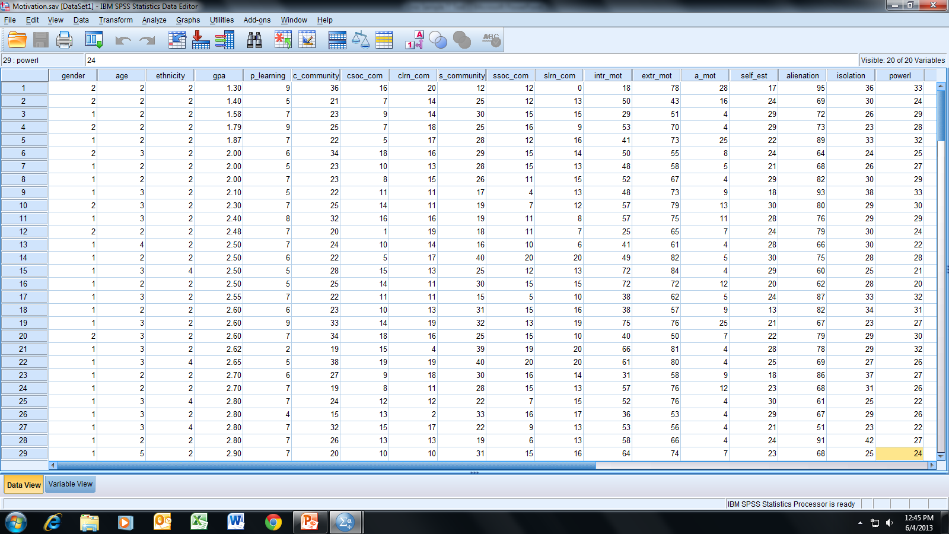
Open the dataset Motivation.sav.
File available at http://www.watertreepress.com/stats
TASK
Randomly select cases from the dataset (i.e., sampling frame) to participate in a study or to analyze.

Slide 4
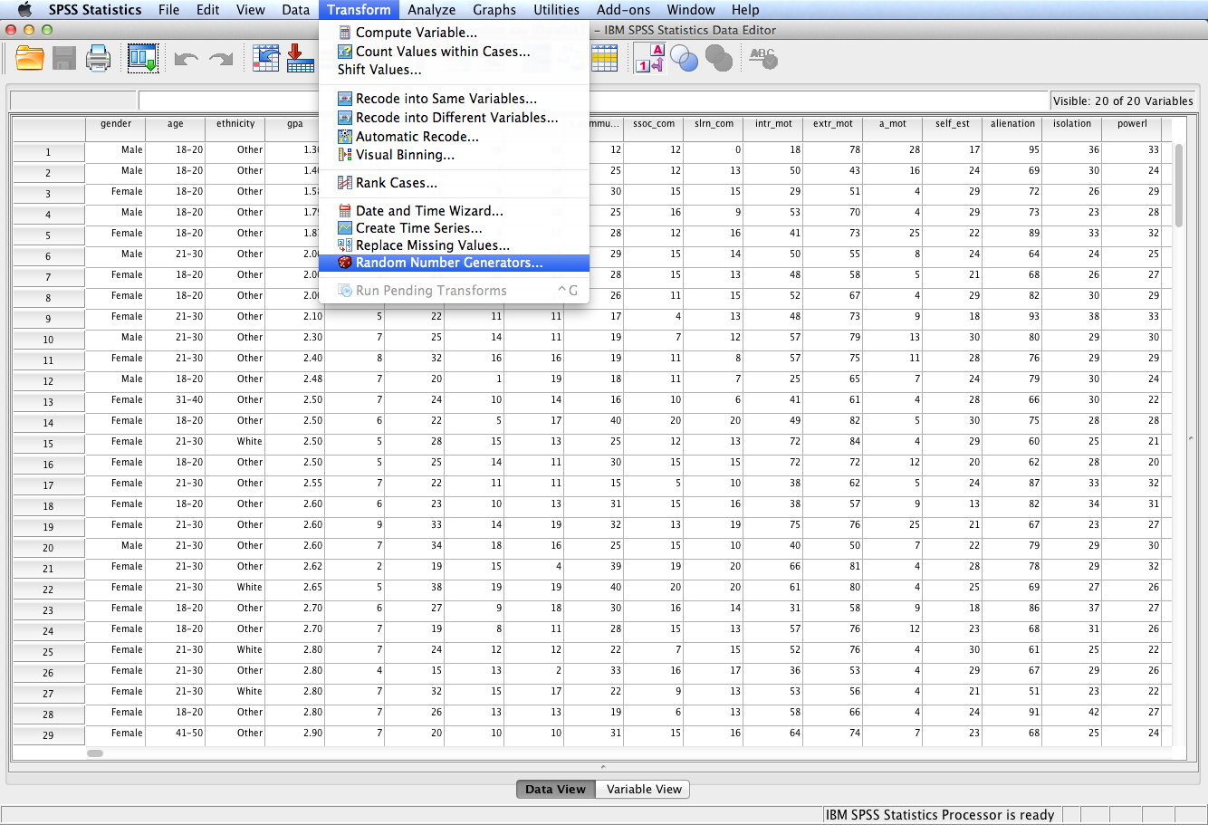
Follow the menu as indicated.

Slide 5
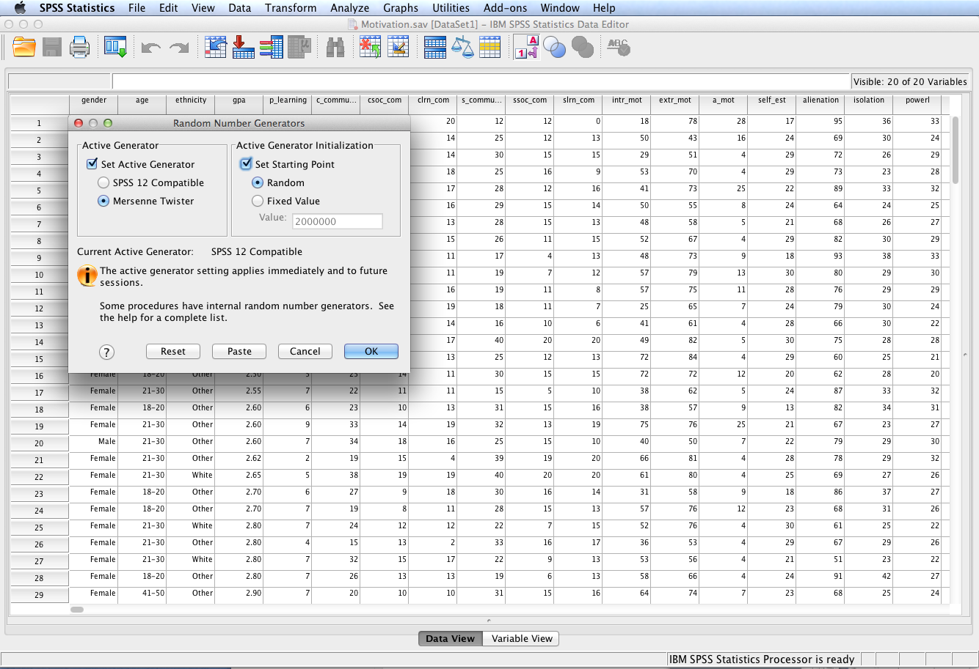
Two different random number generators are available: (1) Version 12 Compatible. The random number generator used in SPSS version 12 and previous releases. Use this option if you need to reproduce randomized results generated in previous releases based on a specified seed value. (2) Mersenne Twister. A newer random number generator that is more reliable for simulation purposes. If reproducing randomized results from version 12 or earlier is not an issue, use this random number generator.
Select Set Active Generator with the Mersenne Twister option and Set Starting Point with a Random option. Click OK.

Slide 6
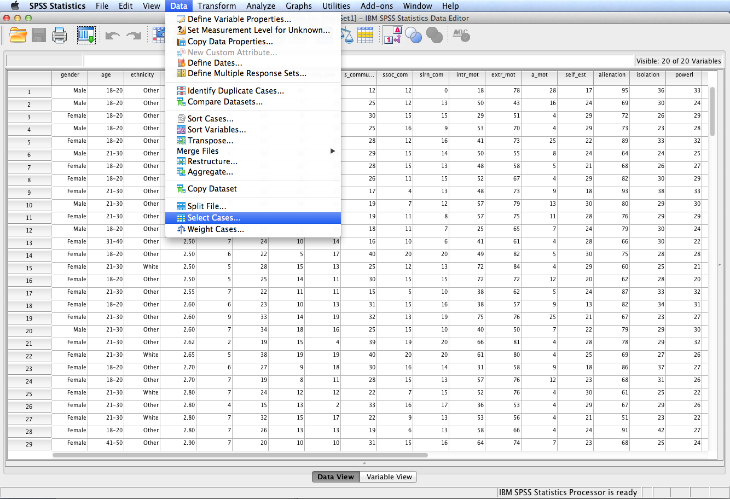
Follow the menu as indicated.

Slide 7
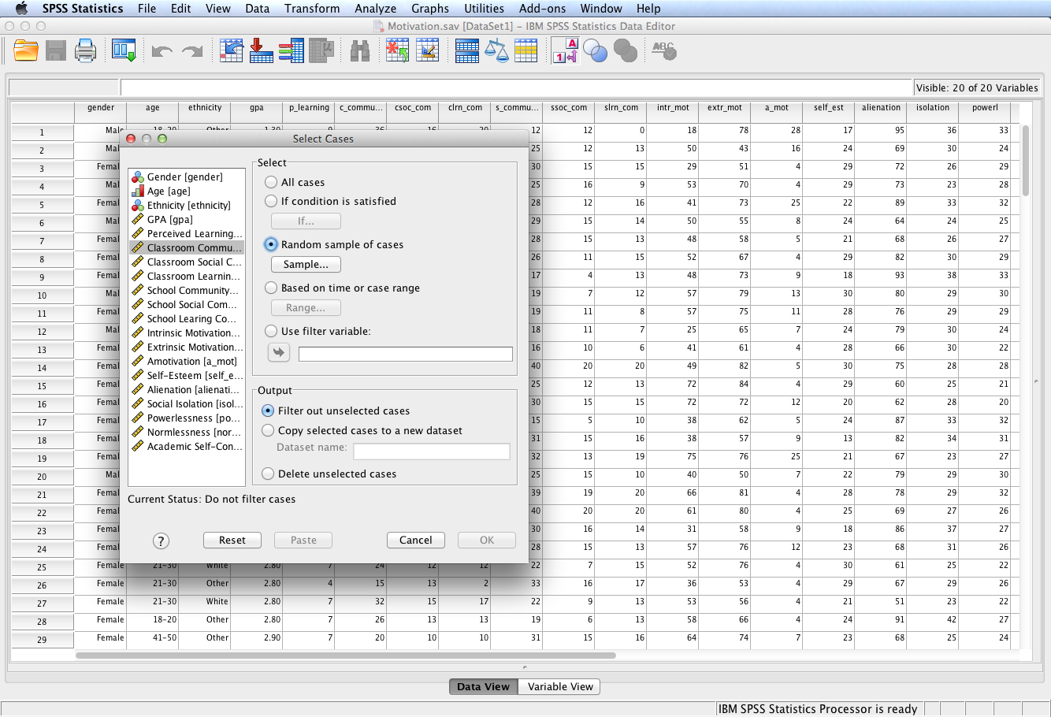
Select Random sample of cases. Click the Sample button.

Slide 8
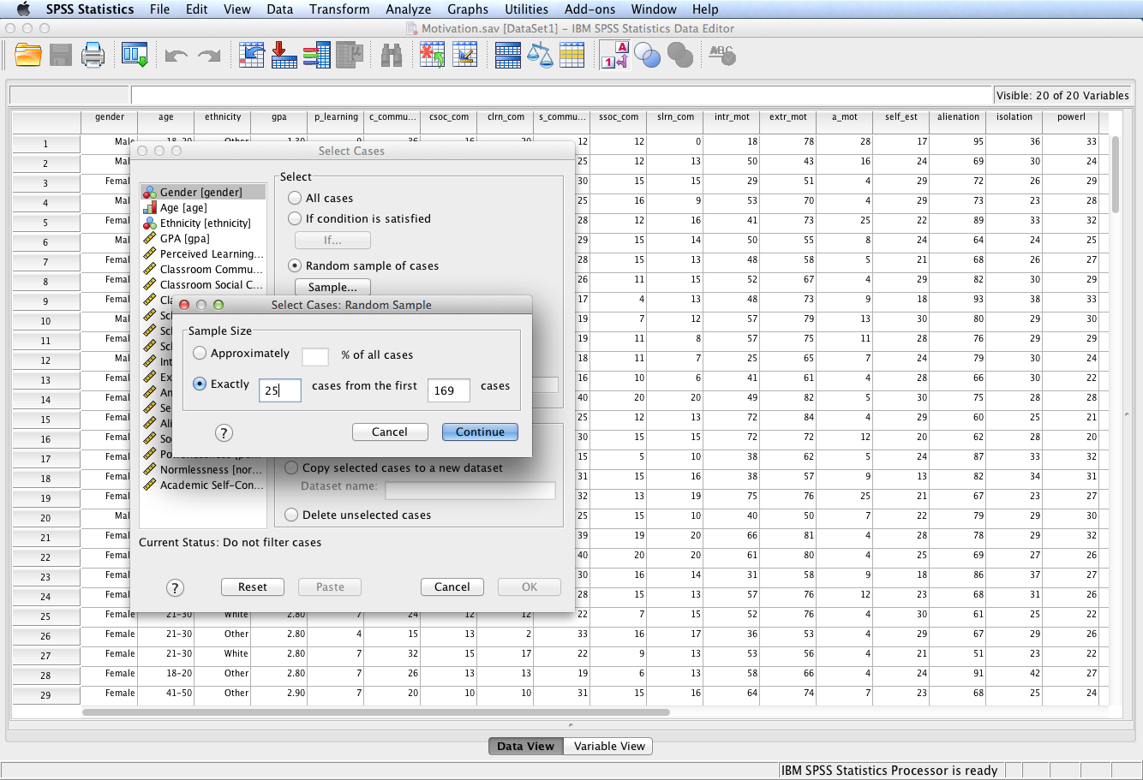
This dialog provides one two options in selecting sample size: select a random sample size based on an approximate percentage or an exact number of cases. The same case cannot be selected more than once.
Select Exactly 25 cases from the first 169 cases. Note: there are 169 cases in the dataset. Click Continue and then OK.

Slide 9
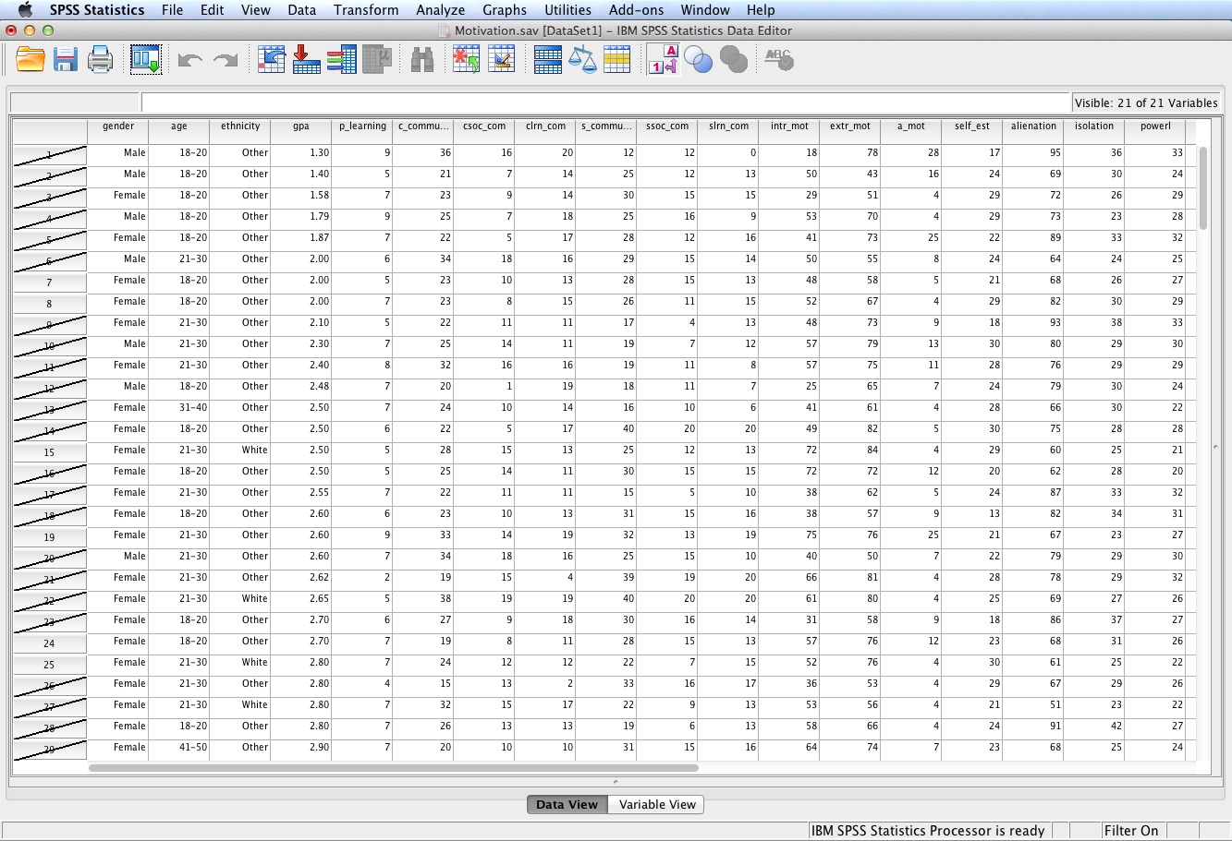
Selected cases constitute a randomly selected group. All subsequent procedures in the current session will be limited to the randomly selected cases.
This procedure can be repeated to randomly assign selected cases to groups. For example, randomly select half the selected cases and assign them to group #1. Assign the remaining selected cases to group #2. Then randomly designate each group as a treatment group or a control group, perhaps by a flip of a coin.

Slide 10
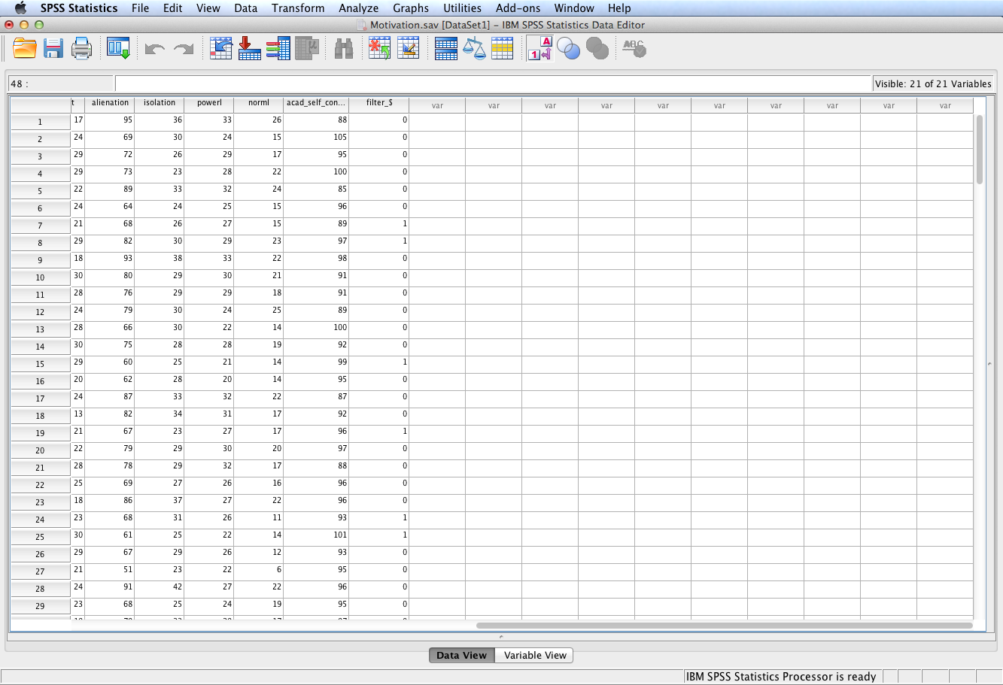
SPSS generates a new variable, filter_$, to identify the selected cases; 0 = not selected, 1 = selected. Rename this variable descriptively and save the modified dataset with this new variable in order to retrieve the same randomly selected sample in future SPSS sessions.

Slide 11
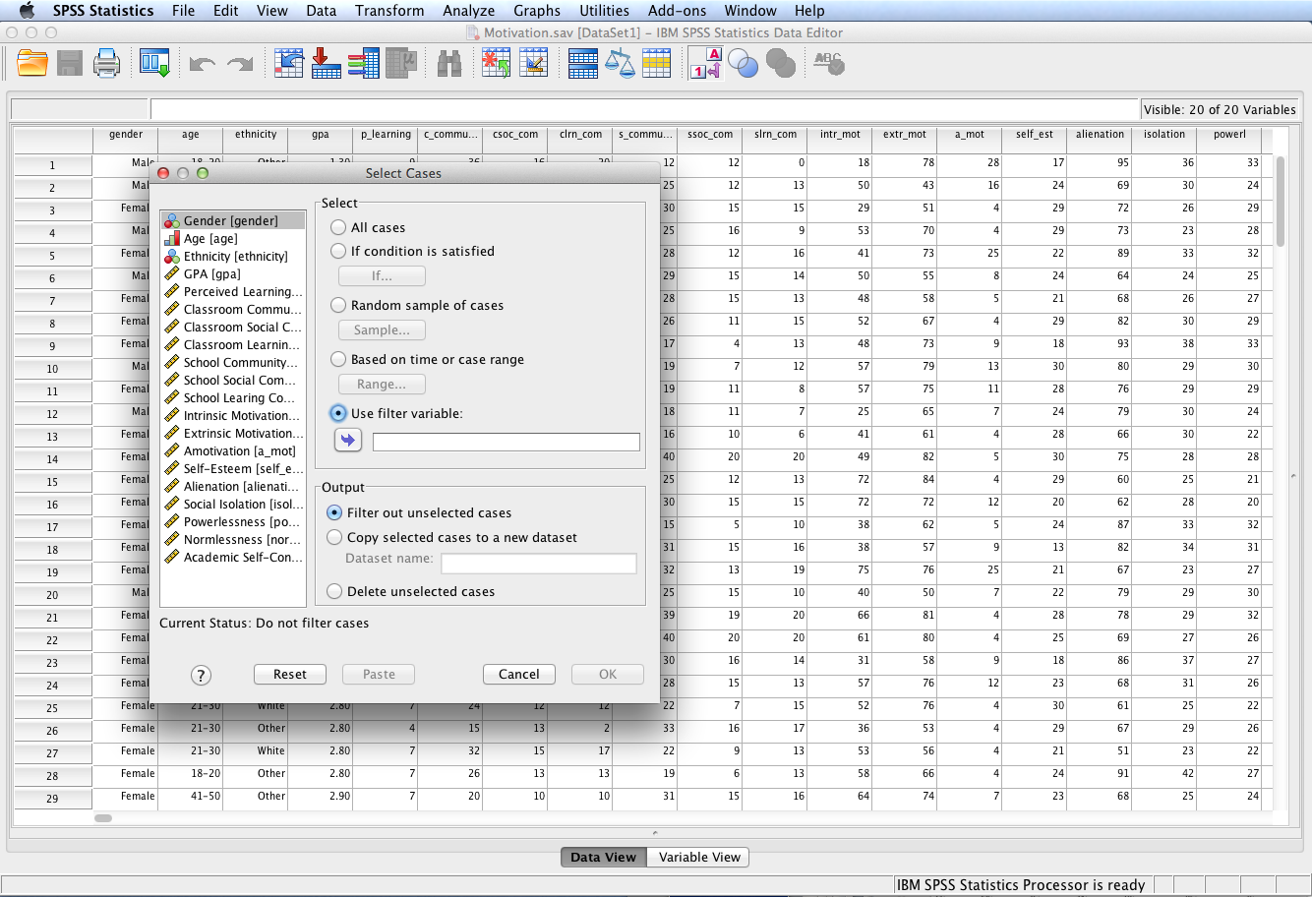
To retrieve the same randomly selected sample in future sessions, execute the Select Cases procedure and select Use filter variable. Enter the name of the filter variable and click OK.

Slide 12
End of Presentation

